Slide 1
18-349: Introduction to Embedded Real-Time Systems
Lecture 19: Implementing PID Control
Anthony Rowe Steven Aday
Electrical and Computer Engineering
Carnegie Mellon University

Slide 2
Overview
Example System
What is a control system?
PID Control
Implementing PID

Slide 3
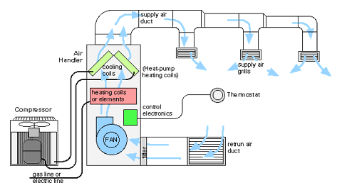
Home HVAC

Slide 4
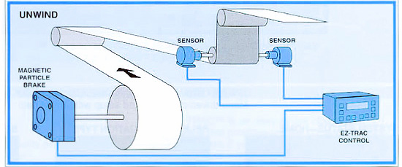
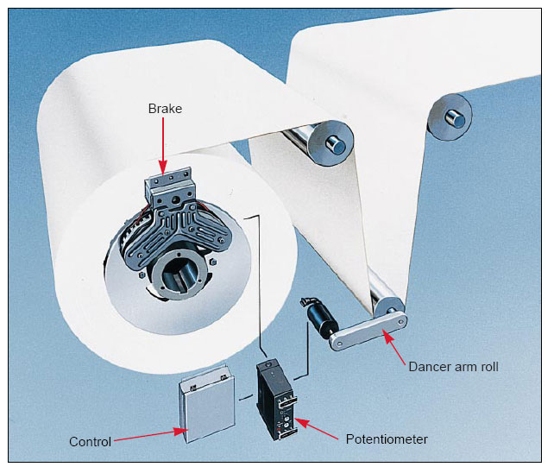
Printing Press

Slide 5
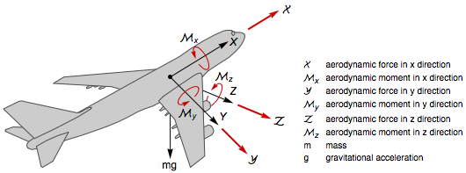
Flight Control

Slide 6
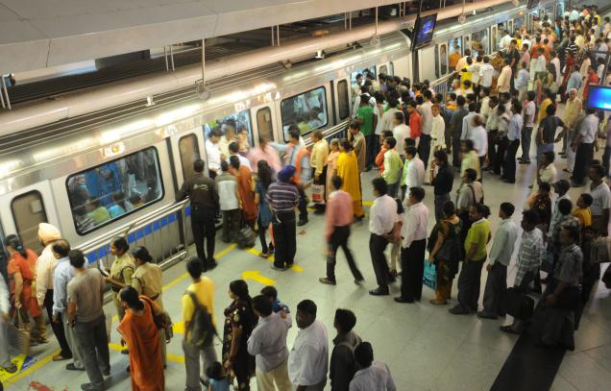
Tokyo Subway (Trains stop at lines)

Slide 7
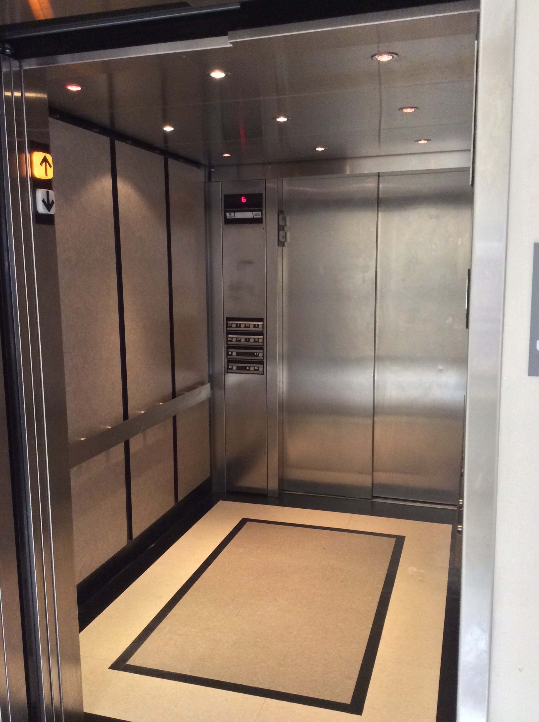
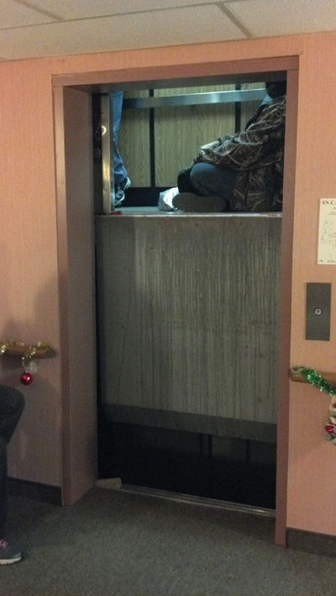
Elevators
✔
✗

Slide 8
Control Systems
We want to control some system
Called a “Plant”
There is an output value we want to achieve
Output is controlled by an input goal called a “set point”
Reference Input (set point)
r_{t}
u_{t}
v_{t+1}
Controller
Plant

Slide 9
Control Systems
One option is to create a model of the Plant
A good model predicts output based on input
u_{t} = F(r_{t})
Below is an example of an “Open Loop” Controller
Reference Input (set point)
r_{t}
u_{t}
v_{t+1}
u_{t} = F(r_{t})
Plant Model
Controller
v_{t}
Plant

Slide 10
Motor Example
You want to control some motor
You realize that the speed is related to the input voltage…
Motor Model: v_{t+1} = 0.7 v_{t} + 0.5 u_{t} + d_{t}
d_{t} is some sort of disturbance in the plant
Control Function: F(r_{t}) = P r_{t}
Desired Speed
Voltage
Motor Speed
r_{t}
u_{t}
v_{t+1}
u_{t} = F(r_{t})
Plant Model
Reference Input (set point)
Controller
v_{t}
Plant

Slide 11
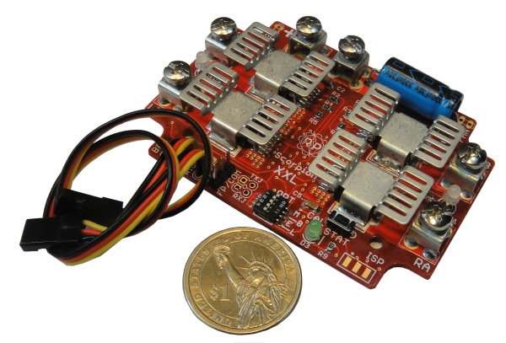
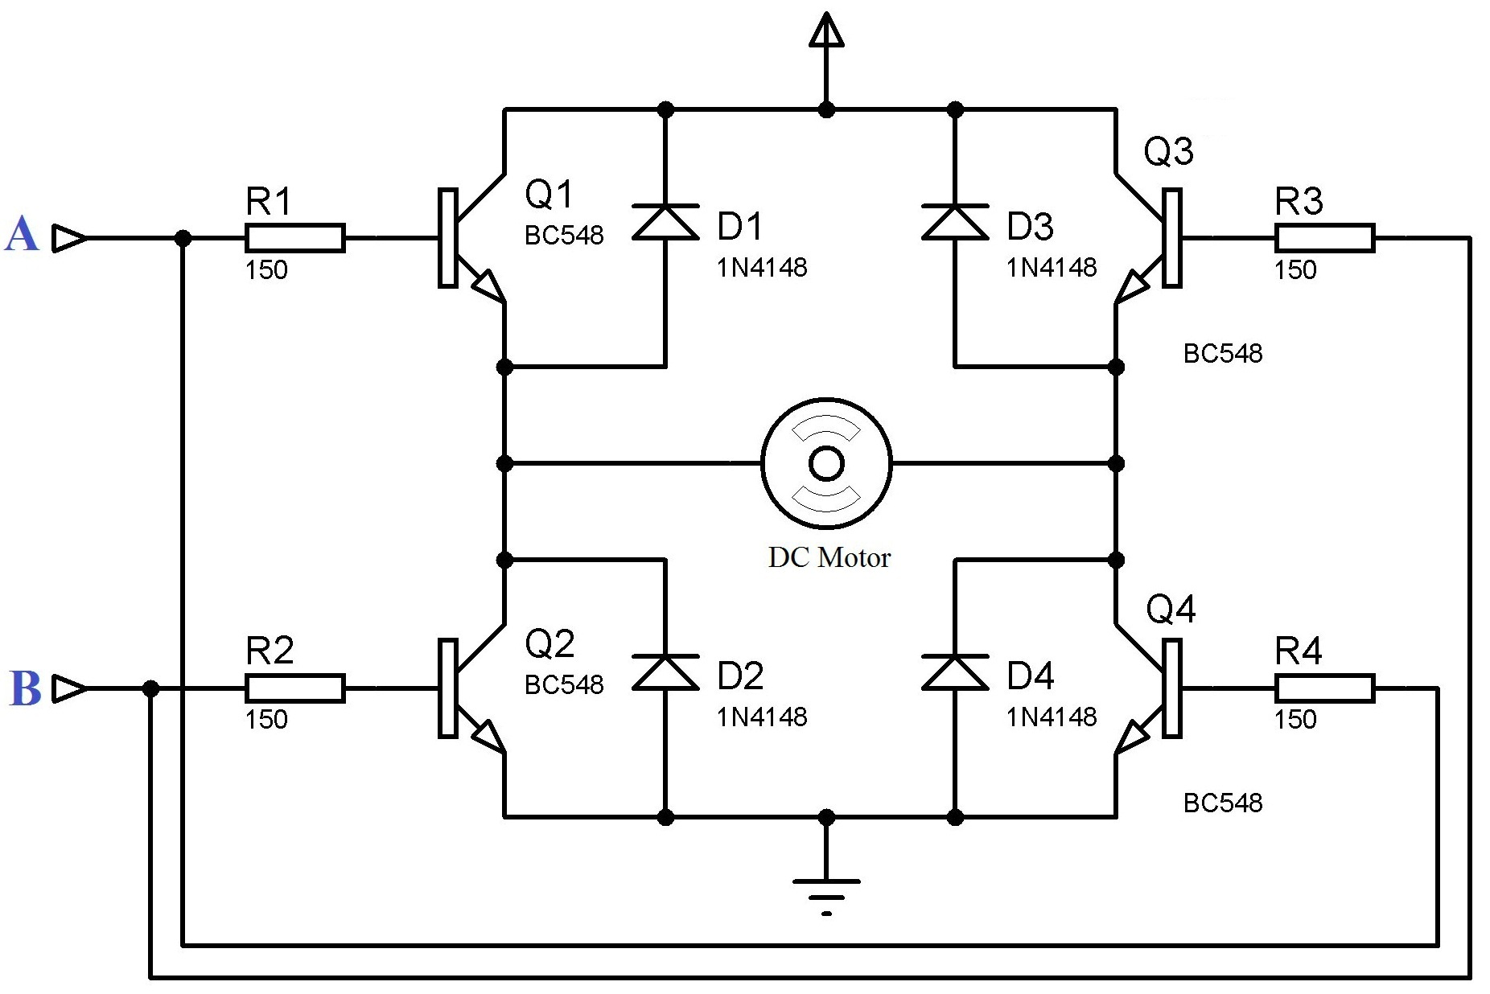
Driving a Motor
Motors draw lots of current
PWM signal used to apply a virtual voltage
H-Bridge (actuator lecture)
GPIO / PWM
GPIO / PWM
Microcontroller

Slide 12
Motor Example
Control Function: F(r_{t}) = P r_{t}
What should P be?
In steady state we measure:
With u_{t} = 3000 mV we get v_{t} = 5000 rpm
With u_{t} = 600 mV we get v_{t} = 1000 rpm
It seems like 1 volt corresponds to a 1666 rpm change?
Desired Speed
Voltage
Motor Speed
r_{t}
u_{t}
v_{t+1}
u_{t} = F(r_{t})
Plant Model
Reference Input (set point)
Controller
v_{t}
Plant

Slide 13
Motor Example
Lets sanity check our model…
Motor Model: v_{t+1} = 0.7 v_{t} + 0.5 u_{t} + d_{t}
With u_{t} = 600 mV we get v_{t} = 1000 rpm
Steady State (at 600mV)
assume V_{t} = 1000 rpm,
V_{t+1} = 0.7 *1000 + 0.5 600
V_{t+1} = 1000
Steady State (at 3000mV)
assume V_{t} = 5000 rpm,
V_{t+1} = 0.7 *5000 + 0.5 3000
V_{t+1} = 5000

Slide 14
Problems with Open Loop Systems
They are “flying” blind
Dead reckoning
Can not respond to disturbances
Extra friction etc.
Controller can not adjust to different plants
Models are probably not linear and could be impossible to derive
Desired Speed
Voltage
Motor Speed
r_{t}
u_{t}
v_{t+1}
u_{t} = F(r_{t})
Plant Model
Reference Input (set point)
Controller
v_{t}
Plant

Slide 15
Open Loop Motor P-Control - Nominal

Slide 16
Open Loop Motor Control – Kf = 1.2

Slide 17
Open Loop Motor Control – +0.5 Nm disturbance

Slide 18
Close Loop Systems
Add feedback so the controller knows result of inputs
If we can measure the difference between the set point and the output we can compute error
Reference Input (set point)
Error: e_{t} = r_{t} - v_{t}
r_{t}
e_{t}
u_{t}
v_{t+1}
u_{t} = F(r_{t})
Plant Model
Controller
v_{t}
Plant
Sensor

Slide 19
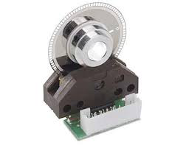
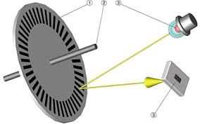
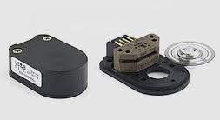
Sensing motor speed (1-3)
Often use optical encoders

Slide 20
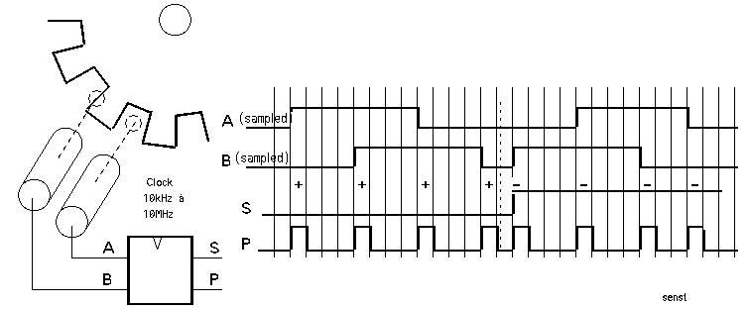
Sensing motor speed (2-3)
Quadrature Encoding
Capture counts and direction

Slide 21
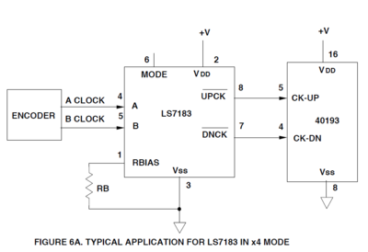
Sensing motor speed (3-3)
Typical circuit
Connect to GPIO interrupts on an MCU
Quadrature to
Up / Down Decoder
MCU

Slide 22
Closed Loop Motor Control – Nominal Bang-Bang

Slide 23
Proportional Control
Simplest controller
F(e_{t}) = K_{p} (e_{t})
Look at the error value
Increase the input as a linear proportional function to the error
Reference Input (set point)
Error: e_{t} = r_{t} - v_{t}
r_{t}
e_{t}
u_{t}
v_{t+1}
u_{t} = F(r_{t})
Plant Model
Controller
v_{t}
Plant
Sensor

Slide 24
Motor Example (Proportional)
With load on the motor we now see:
3000mV is giving a speed of 3000rpm
According to the model it should give 5000rpm!
Error = 5000-3000 = 2000 rpm
Lets boost the voltage by some proportion K_{p} of the error
Assume K_{p} = 0.5
That would mean our new input voltage would be:
3000mV + 0.5 * 2000 = 4000mV
Adding more voltage should certainly help the motor go faster...

Slide 25
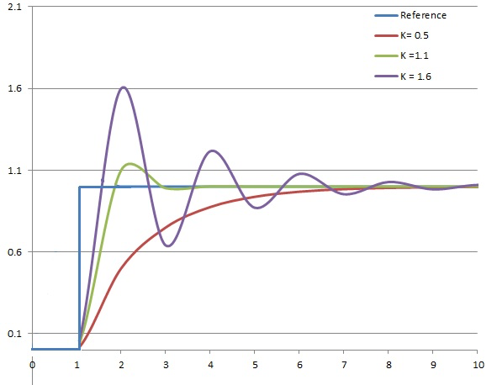
Oscillation
When your error is high, your added input is high
You can then overshoot and oscillate

Slide 26
Closed Loop Motor Control – Nominal P-Control, Kp = 10

Slide 27
Closed Loop Motor Control –P-Control, Kp = 10, Disturbance at t=5

Slide 28
Adding a Derivative Term
What if we look at the rate of change as we approach our target?
If too slow, increase the control input
If too fast, decrease the control input
F(e_{t}) = K_{p} (e_{t}) + K_{d} (e_{t} – e_{t-1} )
This derivative term K_{d} decreases oscillation
It Dampens the control response
r_{t}
e_{t}
u_{t}
v_{t+1}
u_{t} = F(r_{t})
Plant Model
Controller
v_{t}
Plant
Sensor

Slide 29
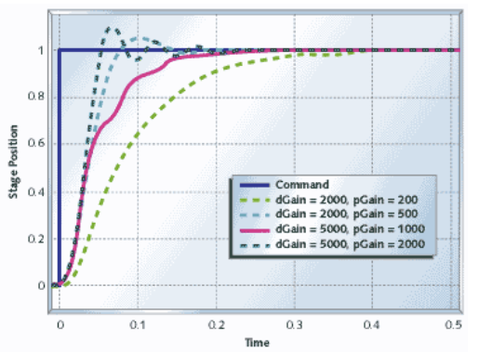
Proportional Derivative (PD) Controller
Over Damped versus Under Damped

Slide 30
Closed Loop Motor Control –PD Control, Kp = 10, Kd = 5

Slide 31
Closed Loop Motor Control –PD Control, Kp = 10, Kd = 2, disturbed

Slide 32
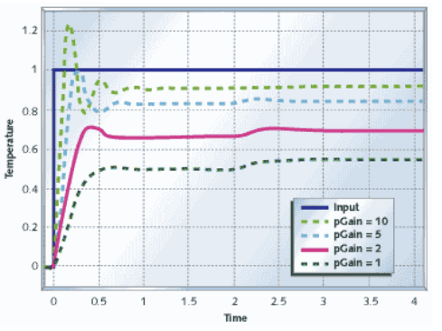
Long-term Cumulative Error
What if you can’t reach your target because of constant error?
For the motor it could be wind, a hill, too much friction etc…

Slide 33
Integral Term
If we sum our error over time, we might see that we need a little extra boost to meet our goal
K_{i} will provide an input based on the integrated error over time
F(e_{t}) = K_{p}(e_{t}) + K_{i}(e₀ + e₁ + e₂ + … + e_{t-1} )
r_{t}
e_{t}
u_{t}
v_{t+1}
u_{t} = F(r_{t})
Plant Model
Controller
v_{t}
Plant
Sensor

Slide 34
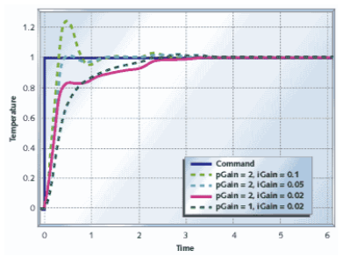
Adding in the Integral Term
In the case of the motor we would slowly add more voltage depending on the long term error
Slowly Increase the input based on long-term Error

Slide 35
Closed Loop Motor Control –PID Control, Ki = 5, disturbed

Slide 36
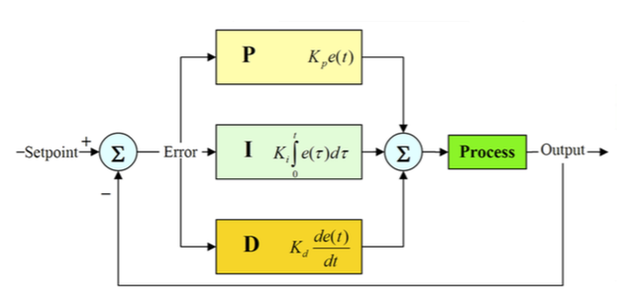
Summary of PID Controller
F(e_{t}) = K_{p} (e_{t}) + K_{d} (e_{t} – e_{t-1} ) + K_{i} (e₀ + e₁ + … + e_{t-1})

Slide 37
PID Implementation
typedef struct {
double dState; // Last position input
double iState; // Integrator state
double iMax, iMin; // Maximum and minimum allowable integrator state
double iGain, // integral gain
pGain, // proportional gain
dGain; // derivative gain
} SPid;
double UpdatePID(SPid * pid, double error, double position) {
double pTerm, dTerm, iTerm;
pTerm = pid->pGain * error;
// calculate the proportional term
// calculate the integral state with appropriate limiting
pid->iState += error;
if (pid->iState > pid->iMax) pid->iState = pid->iMax;
else if (pid->iState < pid->iMin) pid->iState = pid->iMin;
iTerm = pid->iGain * iState; // calculate the integral term
dTerm = pid->dGain * (position - pid->dState); pid->dState = position;
return pTerm + iTerm - dTerm;
}

Slide 38
PID Implementation
typedef struct {
double dState; // Last position input
double iState; // Integrator state
double iMax, iMin; // Maximum and minimum allowable integrator state
double iGain, // integral gain
pGain, // proportional gain
dGain; // derivative gain
} SPid;
double UpdatePID(SPid * pid, double error, double position) {
double pTerm, dTerm, iTerm;
pTerm = pid->pGain * error;
// calculate the proportional term
// calculate the integral state with appropriate limiting
pid->iState += error;
if (pid->iState > pid->iMax) pid->iState = pid->iMax;
else if (pid->iState < pid->iMin) pid->iState = pid->iMin;
iTerm = pid->iGain * iState; // calculate the integral term
dTerm = pid->dGain * (position - pid->dState); pid->dState = position;
return pTerm + iTerm - dTerm;
}
typedef struct {
double dState; // Last position input
double iState; // Integrator state
double iMax, iMin; // Maximum and minimum
// allowable integrator state
double iGain, // integral gain
pGain, // proportional gain
dGain; // derivative gain
} SPid;
double UpdatePID(SPid * pid, double error, double position)
iTerm = pid->iGain * iState; // calculate the integral term
dTerm = pid->dGain * (position - pid->dState);
pid->dState = position;
pTerm = pid->pGain * error;
// calculate the proportional term
// calculate the integral state with appropriate limiting
pid->iState += error;
if (pid->iState > pid->iMax) pid->iState = pid->iMax;
else if (pid->iState < pid->iMin) pid->iState = pid->iMin;
return pTerm + iTerm - dTerm;

Slide 39
How do we pick K_{p}, K_{i}, and K_{d}?
Stability
We want the error to eventually converge to 0
Performance Metrics
Rise time / Response: How long does it take to get to 10% of the final value?
Peak time: Time to reach first peak
Overshoot: Amount in excess of final value
Settling Time: Time before output settles to within 1% of final value

Slide 40
Tuning a PID Controller
A search in 3 Dimensions
ALWAYS instrument system to collect response graphs
If you can’t measure it, you can’t tune it!
Build an Interactive Interface
Set P,I and D terms from a terminal interface quickly
Heuristic Procedure 1 (leading with the D term):
Step 1: Set K_{p} to small value, K_{d} and K_{i} to 0
Step 2: Increasing K_{d} until oscillation, then decrease by factor of 2-4
Step 3: Increase K_{p} until oscillation or overshoot, decrease by 2-4x
Step 4: Increase K_{i} until oscillation or overshoot
Step 5: Is it okay? If not, go to Step 2.

Slide 41
Tuning a PID Controller
Heuristic Procedure 2 (leading with the P term):
Step 1: Set K_{d} and K_{i} to 0
Step 2: Increasing K_{p} until oscillation, then decrease by factor of 2-4
Step 3: Increase K_{i} until loss of stability, then dial it back
Step 4: Increase K_{d} to react against disturbance as needed
Step 5: Is it okay? If not, go to Step 2.

Slide 42
Other Considerations
Sampling Rate
1/10 to 1/100 the settling time
Faster usually makes things easier

Slide 43
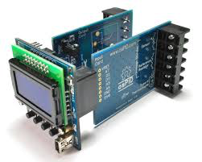
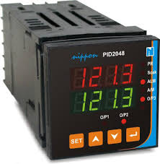
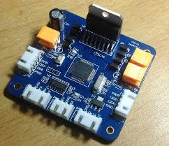
Industrial Controllers

Slide 44
Conclusions
PID control is used by 90% of control systems
Its fun and easy
Every embedded developer should know the basics so you can control stuff
Next Class: Course Wrap-up

